Slide 1
Optogenetics
An Introduction

Slide 2
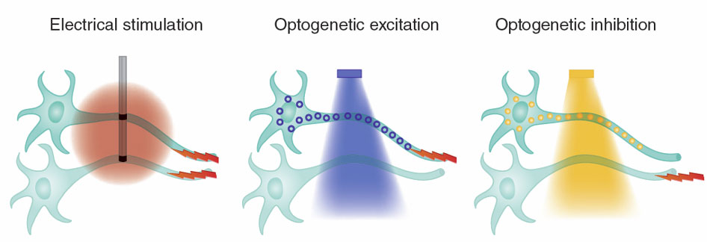
What is Optogenetics?
Controlling Neurons with Light
Using Light-Sensitive Ion Channels
Genetically Transfected into specific cells

Slide 3
Designing Optogenetic Experiments
The 5 Major Steps in the Design of Optogenetic Experiments
1. Select an Opsin
2. Select Targeting Strategy
3. Select Light Delivery Method
4. Choose Temporal Parameters
5. Validation

Slide 4
1. Selecting an Opsin
Suited to Experimental Goals
Excitation or Inhibition of Cells
Potentiated systems
Mapping Complex Circuitry
Determining Causality
Matching the normal activation of the cell
Bi-directional controls
Testing potential Therapies

Slide 5
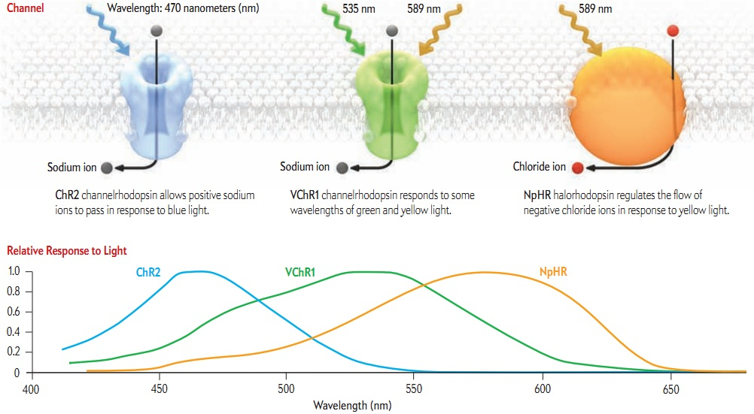
1. Selecting an Opsin
Different Opsins are functionally different

Slide 6
1. Selecting an Opsin
Different Opsins are functionally different

Slide 7
Multiple Optogenetic Tools: Rhodopsin variants

Slide 8
Channel Rhodopsin
Ion Channel
Cations
Na⁺, Ca⁺⁺
Excitatory
Depolarization
Light stimulates neuronal activity

Slide 9
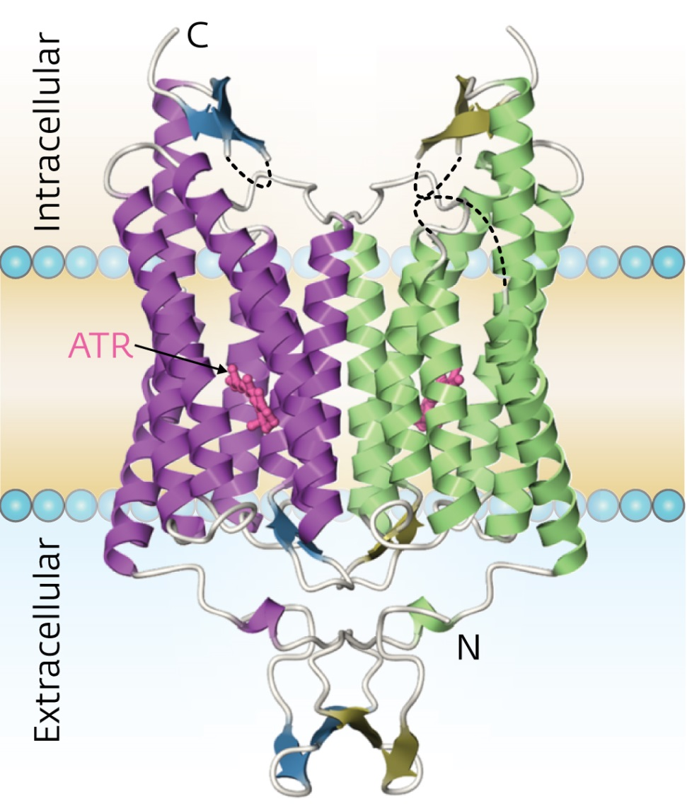
Channel Rhodopsin
Ion Channel
Cations
Na⁺, Ca⁺⁺
Excitatory
Depolarization
Light stimulates neuronal activity

Slide 10
Halorhodopsin
Ion Channel
Anions
Cl⁻
Inhibitory
Hyperpolarization
Fast
Light stimulates neuronal inactivity

Slide 11
Bacteriorhodopsin Proteorhodopsin
Ion Channel
Protons
H⁺
Inhibitory
Hyperpolarization
Fast
Light stimulates neuronal inactivity

Slide 12
1. Selecting an Opsin

Slide 13
OptoXR
Opsin-Receptor Chimaeras
Membrane Bound
Intracellular loops of Rhodopsin replaced with G protein loops
E.g. Optoα₂ or Optoβ₂
Activates specific
2nd messengers
Excitatory or Inhibitory
Light can match normal neuronal activity

Slide 14
Cytoplasmic Optogenetics
Soluble Receptors
Mimics Signaling Cascades

Slide 15
1. Selecting an Opsin

Slide 16
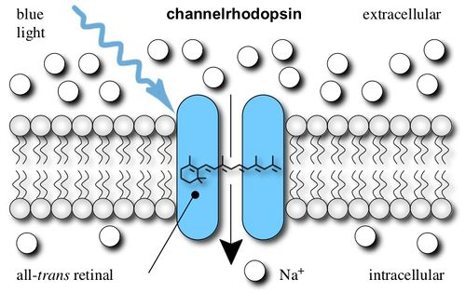
New Opsin Variants
Engineered Channelrhodopsin variants
ChETA (E123 by Thr and Ala variants)
ChIEF http://www.openoptogenetics.org/index.php?title=Channelrhodopsins#tab=Variants
Evoke ultrafast firing frequencies for fast spiking neurons
Help match the synchrony and patterning of the physiological neural code

Slide 17
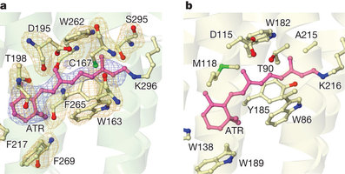
Engineered Channelrhodopsin variants
ChETA (E123 by Thr and Ala variants)
ChIEF http://www.openoptogenetics.org/index.php?title=Channelrhodopsins#tab=Variants
Evoke ultrafast firing frequencies for fast spiking neurons
Help match the synchrony and patterning of the physiological neural code

Slide 18
1. Selecting an Opsin

Slide 19
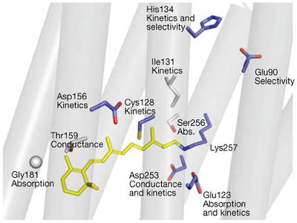
New Opsin Variants
Stabilized Step-Function Opsin variants
Long lasting sub-threshold membrane depolarization
Mimics potentiated systems
Raising the resting potential near the threshold – Enhanced sensitivity to Light
E.g. ChR2 – Asp156Ala + Cys128Ser
Double mutant

Slide 20
1. Selecting an Opsin

Slide 21
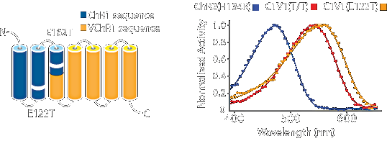
New Opsin Variants
Red-shifted Activation Wavelength
Significantly more potent
Increasing feasibility
Combinatorial excitation
Distinct patterns
E.g. ChR1/VChR1 chimaera (C1/V1)

Slide 22
1. Selecting an Opsin

Slide 23
2. Selecting a Target Strategy
Local Cell Bodies
And their projection sites
Specific Cells within a group
Recombinase or Promoter dependent
Combinations of Opsins
E.g. ChR2 to excite, NpHR to inhibit

Slide 24
2. Target Local Cell Bodies
Action at All Projections ↑ ↑
Action at Limited Projections ↑ ↑

Slide 25
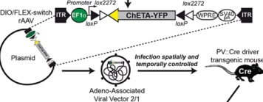
2. Target Specific Local Cells
Action from Specific Local Cells ↑↑
Action at Parvalbumen (GABA) Cells ↑ ↑

Slide 26
2. Target Specific Local Cells
Action from Specific Local Cells ↑↑
TH
or Action at Tyrosine Hydroxylase (DA) Cells ↑ ↑

Slide 27
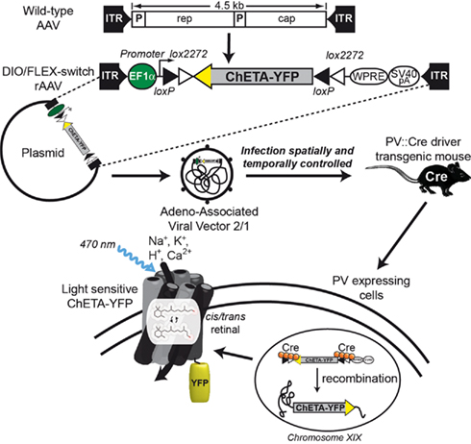
Targeting
Cre = cyclization recombination
Cre Recombinase is a site-specific DNA recombinase that recognizes specific sequences of DNA termed loxP
loxP = locus of crossover of P1 phage
Floxed = DNA “flanked
by loxP” sites

Slide 28
2. Retrograde Target Cells or Terminals
Action from Terminals ↑ ↑ or Cells
Action at ↑ ↑ specific Terminals

Slide 29
Optogenetics in the NAc
Stimulates operant responding (VTA)
Enhances CCP (cocaine conditioned place preference)
Via D₁
Via OptoD₁ = G_{s}
via ACh interneurons
Suppresses CPP (via D₂)
Produces Self-stimulation
BLA → NAc
OptoD₁R

